Slide 1

WORLD ENERGY CONSUMPTION ANALYSIS TO PREDICT THE GREENHOUSE GAS EMISSION USING BIGDATA TECHNOLOGIES
Submitted By:
Pratik Phasale (230960925010)
Rajshree Athawale (230960925011)
Rasika Gawde (230960925012)
Group Number: 04

Slide 2
PROJECT DESCRIPTION
The project leverages big data technologies such as Hadoop, Hive, and Spark to analyze historical data on energy consumption patterns and greenhouse gas emission.
We apply linear regression and gradient boosting regression algorithms to develop a predictive framework that provides insights into future energy trends and greenhouse gas emission.
This framework empowers policymakers, energy companies, and stakeholders to make informed decisions to mitigate climate change.

Slide 3
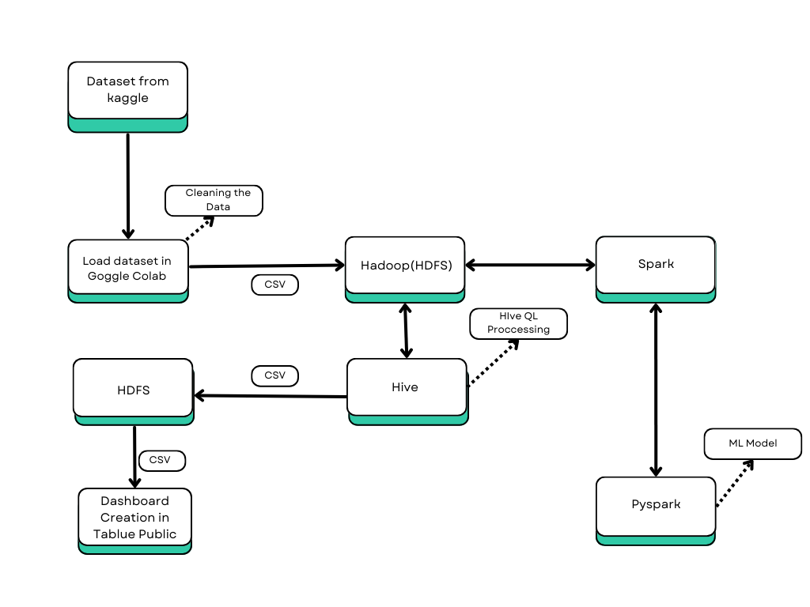
PROJECT ARCHITECTURE

Slide 4
DATASET
Dataset in comma separated value (csv) form taken from Kaggle.
Dataset Name : World Energy Consumption.
Dataset Description : Contains 22013 rows and selected 12 columns.
Features : Country, Year, Coal Consumption, Coal Electricity, Coal production, Electricity generation, Fossil Fuel Consumption, Gas Consumption, Gas Production, Oil Consumption, Oil Electricity.
Label : Greenhouse Gas Emission.

Slide 5
STEPS FOR PROJECT
Step 1 : Dataset of World Energy Consumption is taken from Kaggle website.
Step 2 : Preprocessing and cleaning datasets using Python to ensure data integrity. Transform the dataset into csv file.
Step 3 : CSV file from Google Colab load into Hadoop (HDFS).Processed data is stored and managed in the Hadoop Distributed File System (HDFS).
Step 4 : Load the csv file into Spark and run the Machine Learning Model (Linear Regression and Gradient Boosting Regression) using Pyspark to make prediction.

Slide 6
Step 5 : Load the dataset from HDFS to Hive to process and analyze the data using HiveQL. Convert data frame into csv and load the file back into HDFS.
CREATE TABLE energy (
country STRING,year INT,coal_consumption FLOAT,coal_electricity FLOAT,coal_production , FLOAT,electricity_generation FLOAT,fossil_fuel_consumption FLOAT,gas_consumption FLOAT,gas_production FLOAT,oil_consumption FLOAT,oil_electricity FLOAT,
greenhouse_gas_emission FLOAT)ROW FORMAT DELIMITED FIELDS TERMINATED BY ',' STORED AS TEXTFILE TBLPROPERTIES ('skip.header.line.count'='1');
LOAD DATA LOCAL INPATH '/home/hadoop/WorldEnergyConsumption.csv’ INTO TABLE energy;
Step 6 : Take the csv file loaded into HDFS from Hive and use it in Tableau Public.
Step 7 : Finally, we visualize the output by creating interactive dashboard using Tableau Public.

Slide 7
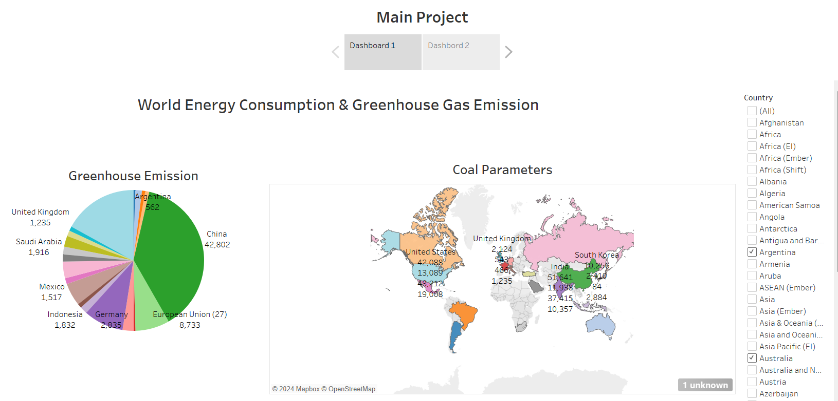
DASHBOARD

Slide 8
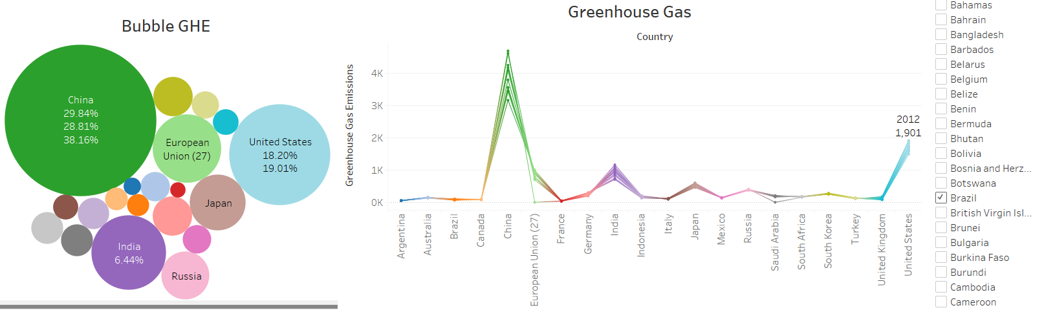
DASHBOARD

Slide 9
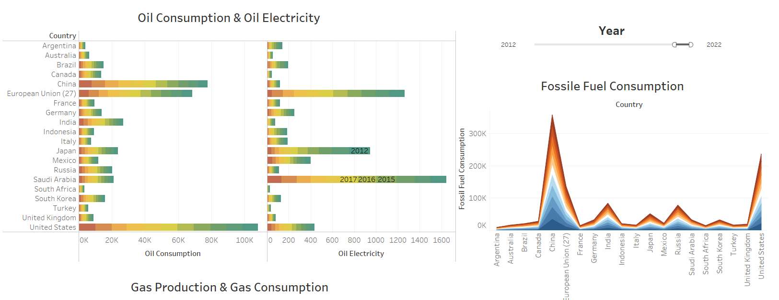
DASHBOARD

Slide 10
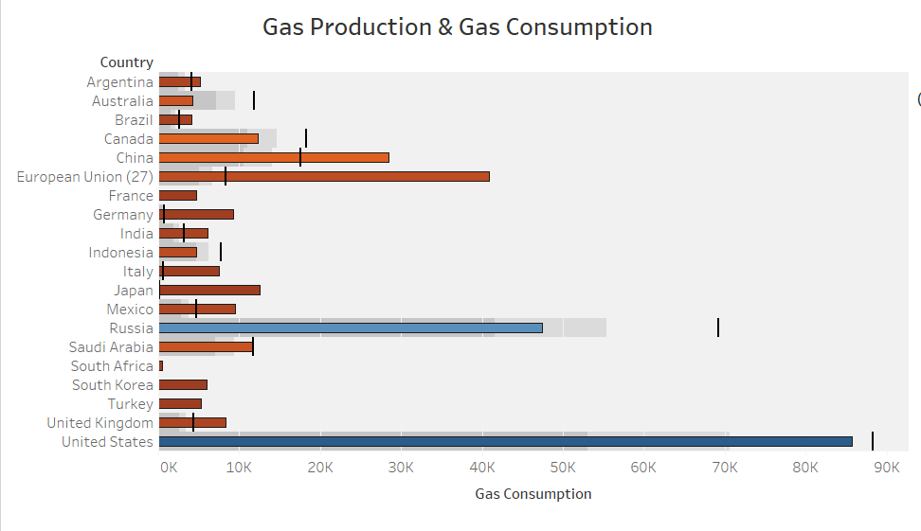
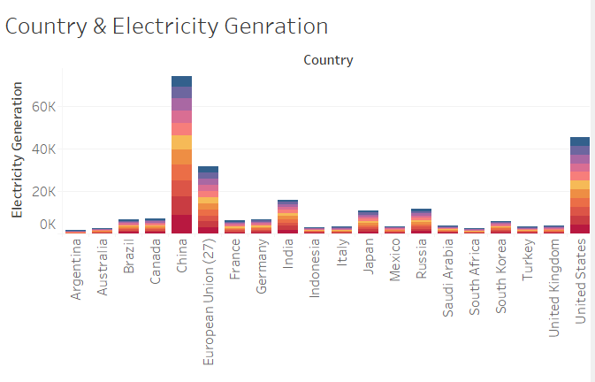
DASHBOARD

Slide 11
CHALLENGE FACED
Finding Dataset.
Selecting proper columns and changing data types of column for processing.
Difficulties in Building Machine Learning models.
Difficulties in archiving Accuracy in Machine Learning models.
Challenge faced during Hive and Spark connectivity in Hadoop.

Slide 12
REFERENCES
Dataset : https://www.kaggle.com/datasets/pralabhpoudel/world-energy-consumption
Notebook : https://www.kaggle.com/code/vritneyclareena/group-project/notebook

Slide 13
THANK YOU

